Slide 1


Slide 2



E-LEARNING APPLICATION
STUDENT MODE
P.I.L.A
TEACHER MODE
PACRES INTEGRATED LEARNING APPLICATION

Slide 3





E-LEARNING APPLICATION
STUDENT MODE
TEACHER MODE

Slide 5
PROJECT DESCRIPTION
Quiz game
Reading level tracker
Assist student’s learning
Progress manager
Help teachers manage student’s grades and performance

Slide 6
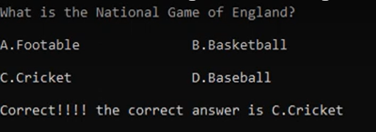
PROJECT DESCRIPTION
FEATURES:
Assist student’s learning
Quiz game
Reading level tracker
Help teachers manage student’s grades and performance
Progress manager

Slide 7
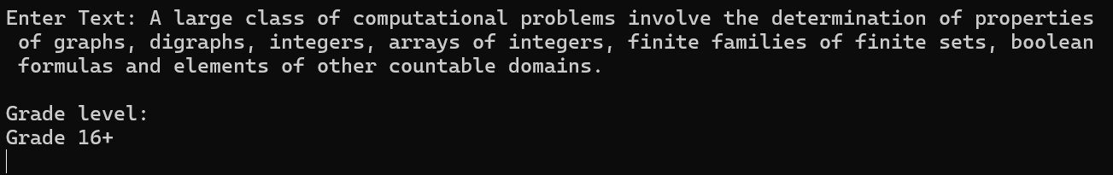
PROJECT DESCRIPTION
FEATURES:
Assist student’s learning
Quiz game
Help teachers manage student’s grades and performance
Reading level tracker
Progress manager

Slide 8
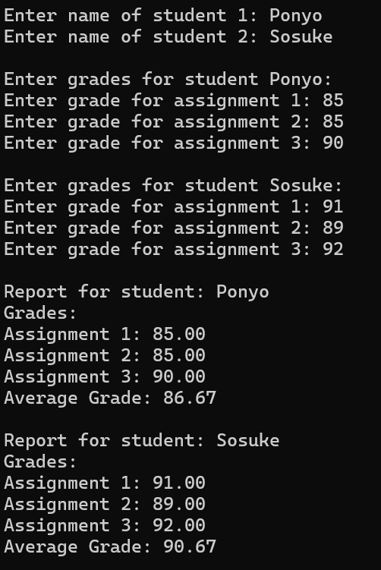
PROJECT DESCRIPTION
FEATURES:
Assist student’s learning
Reading level tracker
Help teachers manage student’s grades and performance
Quiz game
Progress manager

Slide 9
PROJECT DESCRIPTION
FEATURES:
Assist student’s learning
Progress manager
Help teachers manage student’s grades and performance
Quiz game
Reading level tracker

Slide 10
TECHNICAL DETAILS
Concepts Utilized:
Functions
Arrays
Pointers
Dynamic Memory Allocation
Structures
Implementation Plan:
Design UI & sign in function
Implement functions and structures
Use arrays and I/O functions to store info
Use pointers and DMA for memory management

Slide 11
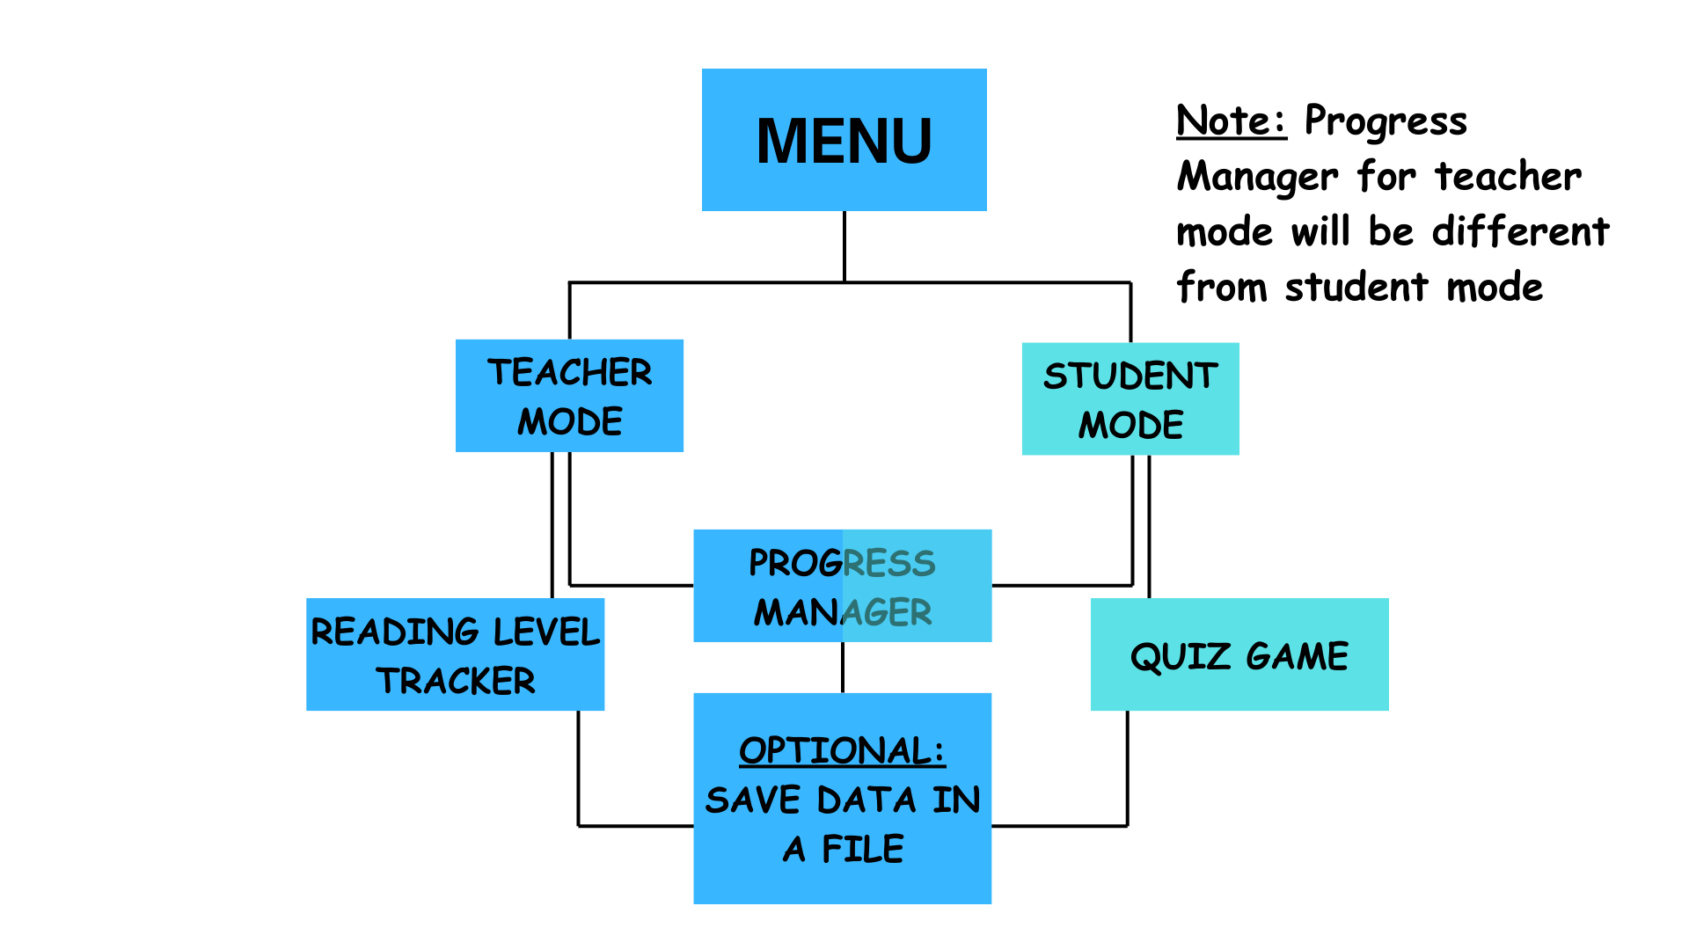

TECHNICAL DETAILS
Implementation Plan:
Design UI & sign in function
Implement functions and structures
Use arrays and I/O functions to store info
Use pointers and DMA for memory management
Concepts Utilized:
Functions
Arrays
Pointers
Dynamic Memory Allocation
Structures
Challenges and solutions:
Memory Management – Pointers & DMA
Time constraints – Believe in myself
Save data for future use – file handling functions

Slide 12
TECHNICAL DETAILS
Concepts Utilized:
Functions
Arrays
Pointers
Dynamic Memory Allocation
Structures
Implementation Plan:
Design UI & sign in function
Implement functions and structures
Use arrays and I/O functions to store info
Use pointers and DMA for memory management
Challenges and solutions:
Memory Management – Pointers & DMA
Time constraints – Believe in myself
Save data for future use – file handling functions

Slide 13
TECHNICAL DETAILS
Challenges and solutions:
Memory Management – Pointers & DMA
Time constraints – Believe in myself
Save data for future use – file handling functions
Implementation Plan:
Design UI & sign in function
Implement functions and structures
Use arrays and I/O functions to store info
Use pointers and DMA for memory management

Slide 14
PROJECT SCOPE
Develop comprehensible interface
Implement quiz games
Design reading level calculator
File handling might be tedious to implement

Slide 15
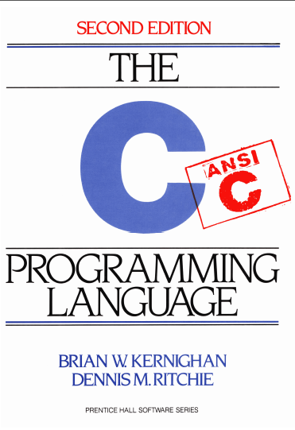
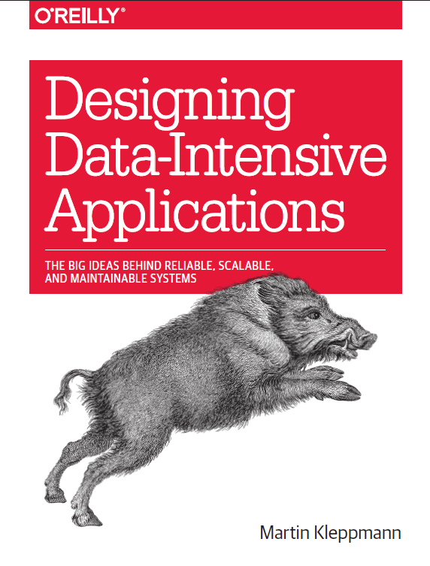

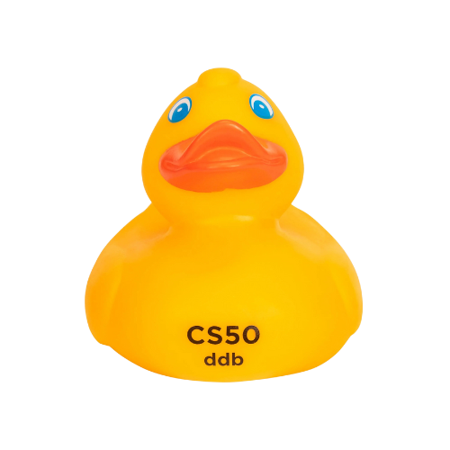




TIMELINE
May 3 – 11 – Coding
May 11 – 17 – Debugging
May 17 – Program presentation

Slide 16
RESOURCES

Slide 18
P.I.L.A
PACRES INTEGRATED LEARNING APPLICATION

Slide 20


